Slide 1
Predicting the Number of Asthma Patients Visiting the Emergency Department
Heng-Ru May Tan
Notes:
Can we estimate Asthma Patient Volume to better prepare for the needs of ED ?

Slide 2
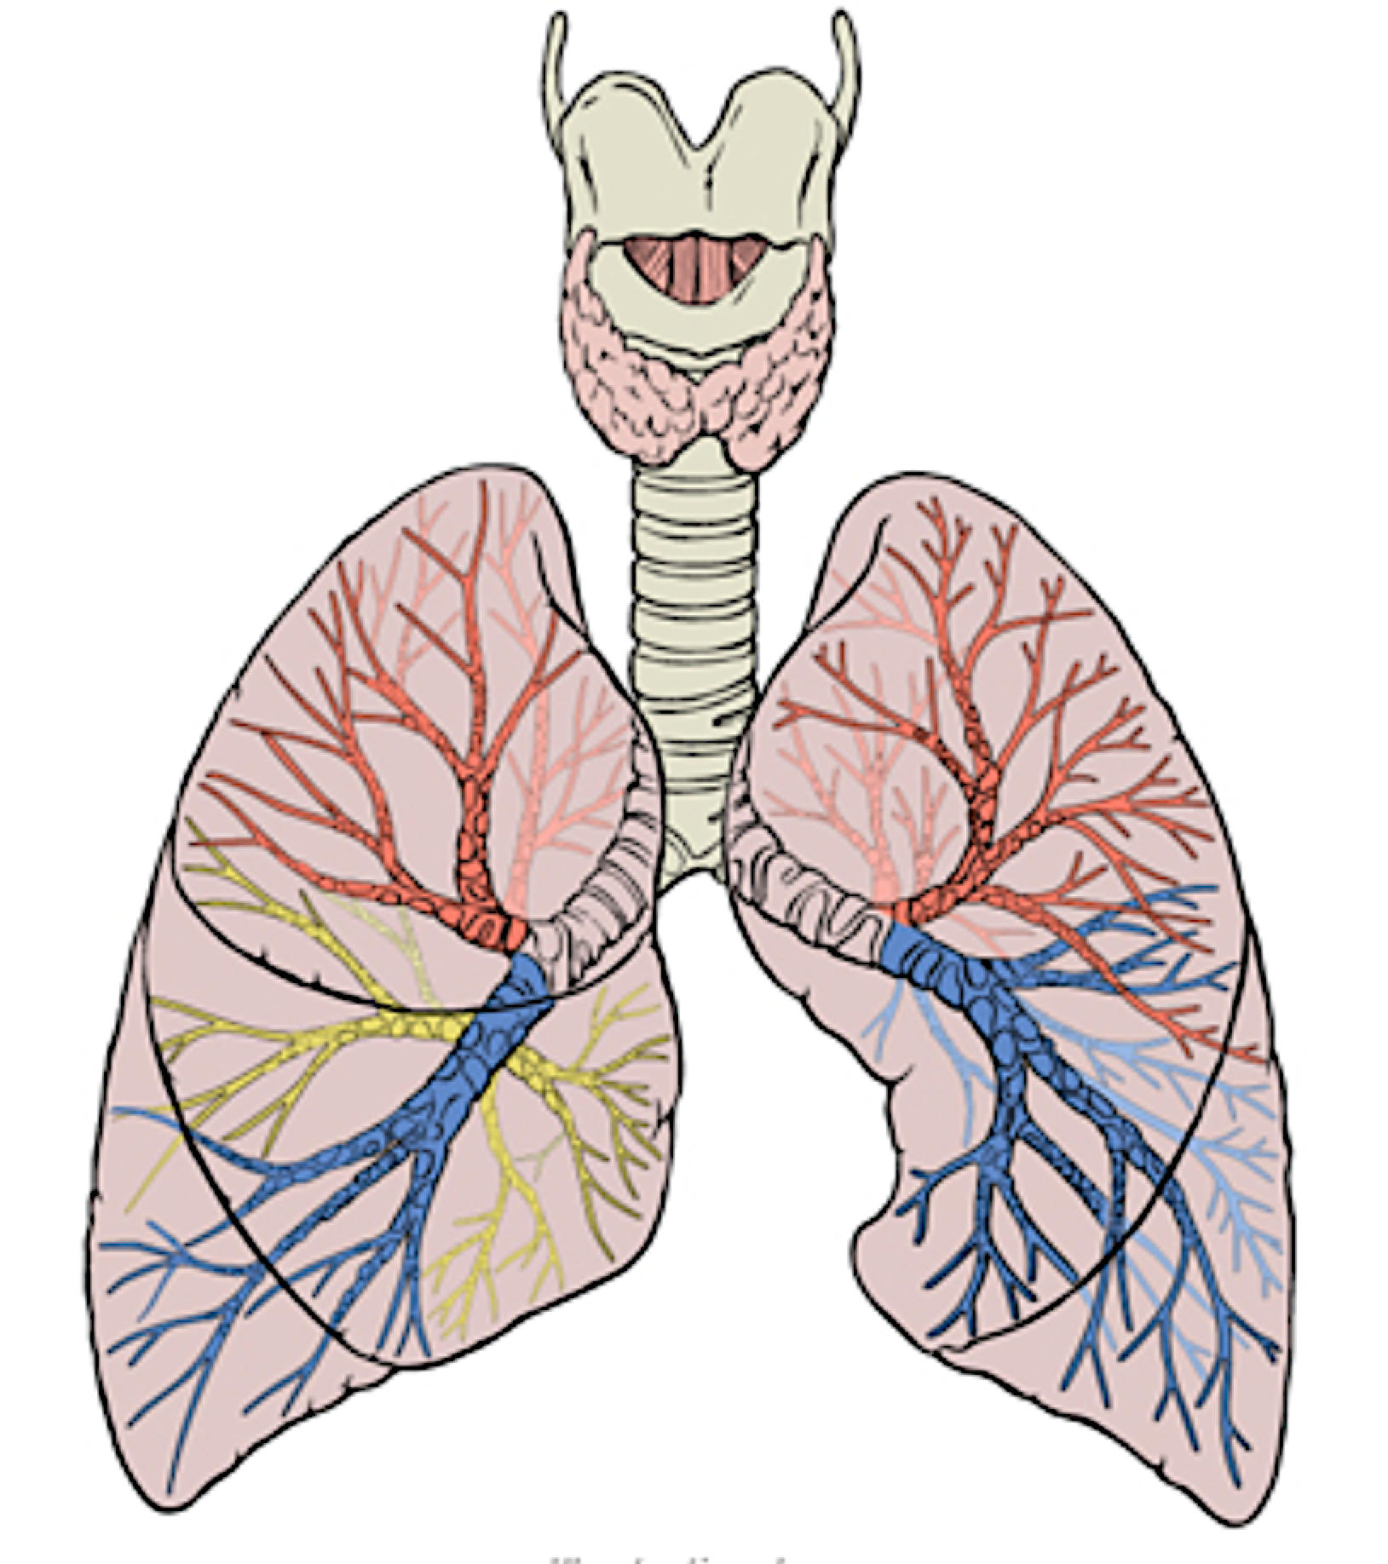
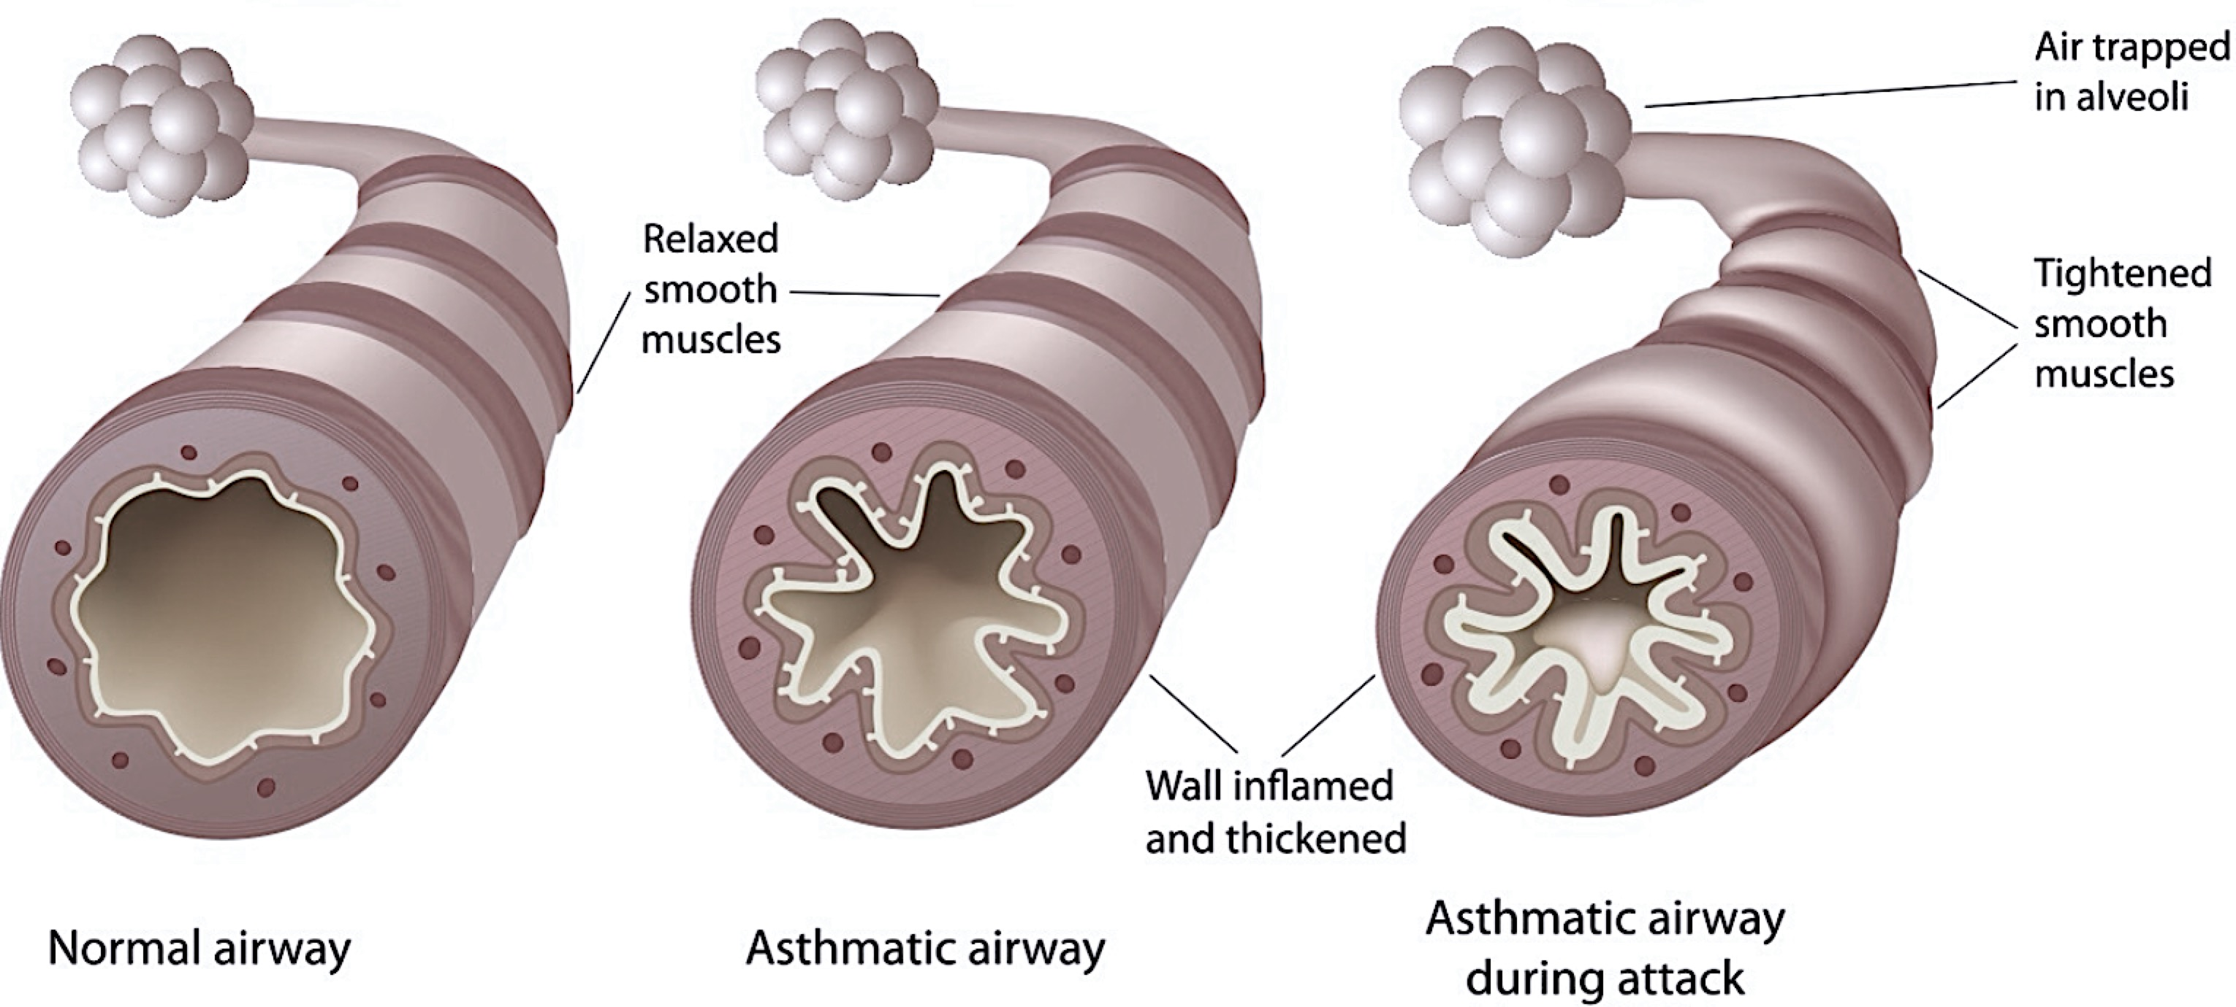

Motivation: Health
Asthma – inflamed airways:
TRIGGERs of Asthma attacks (excess mucus):
Allergens e.g. pet dander, dust mites, pollen or mold.
Non-allergens e.g. smoke, pollution, cold air, weather changes
US Prevalence: CDC (2016) – 1 in 14
US Mortality (CDC, 2013):
10 per day
3,630 per year
Many avoidable with proper treatment and care
3rd leading cause of children’s hospital stays (CDC, 2010)
Notes:
Exercised-induced | Allergic | Occupational | Childhood
Asthma is a disease that affects the part of the lungs called the bronchial tubes (also called airways). If you have asthma, your airways are extra sensitive to the things you are allergic to (called allergens) and to other irritating things you breathe in (called irritants). These things are sometimes called “triggers.” Being exposed to triggers can cause an asthma attack. An asthma attack happens when excess mucus causes your airways to swell and tighten
http://www.aafa.org/page/asthma-facts.aspx
http://www.aafp.org/dam/AAFP/documents/news/COPD-Asthma_Patient_Ed_handout.pdf
http://www.aaaai.org/conditions-and-treatments/asthma
The most common symptom is wheezing. This is a scratchy or whistling sound when you breathe. Other symptoms include:
• Shortness of breath
• Chest tightness or pain
• Chronic coughing
• Trouble sleeping due to coughing or wheezing
Asthma is a leading chronic health condition among children. The greatest rise in asthma rates was among black children (almost a 50% increase) from 2001 through 2009.22 There are also large racial, income, and geographic disparities in poor asthma outcomes.1,6
http://ephtracking.cdc.gov/showIndicatorPages.action?selectedContentAreaAbbreviation=AS&selectedIndicatorId=90&selectedMeasureId=

Slide 3

Motivation: Service
Hospital Emergency Department:
Unplanned patient attendance
Provide initial treatment for a broad spectrum of illnesses and injuries:
Non-life threatening
Life-threatening: immediate attention.
Important entry points for those without other means of access to medical care.
The annual cost of asthma ~$56 billion; ~$50 billion (direct; Hospital stays*) (CDC, 2012)
Need for resource management:
Staffing needs
Drug/ Prescription inventory
Facility units
Could we predict when the ED will have above median visits for asthma?
Notes:
http://www.aafa.org/page/asthma-facts.aspx
http://www.aafp.org/dam/AAFP/documents/news/COPD-Asthma_Patient_Ed_handout.pdf
Asthma is a disease that affects the part of the lungs called the bronchial tubes (also called airways). If you have asthma, your airways are extra sensitive to the things you are allergic to (called allergens) and to other irritating things you breathe in (called irritants). These things are sometimes called “triggers.” Being exposed to triggers can cause an asthma attack. An asthma attack happens when excess mucus causes your airways to swell and tighten
http://www.aaaai.org/conditions-and-treatments/asthma
The most common symptom is wheezing. This is a scratchy or whistling sound when you breathe. Other symptoms include:
• Shortness of breath
• Chest tightness or pain
• Chronic coughing
• Trouble sleeping due to coughing or wheezing
Asthma is a leading chronic health condition among children. The greatest rise in asthma rates was among black children (almost a 50% increase) from 2001 through 2009.22 There are also large racial, income, and geographic disparities in poor asthma outcomes.1,6
http://ephtracking.cdc.gov/showIndicatorPages.action?selectedContentAreaAbbreviation=AS&selectedIndicatorId=90&selectedMeasureId=

Slide 4

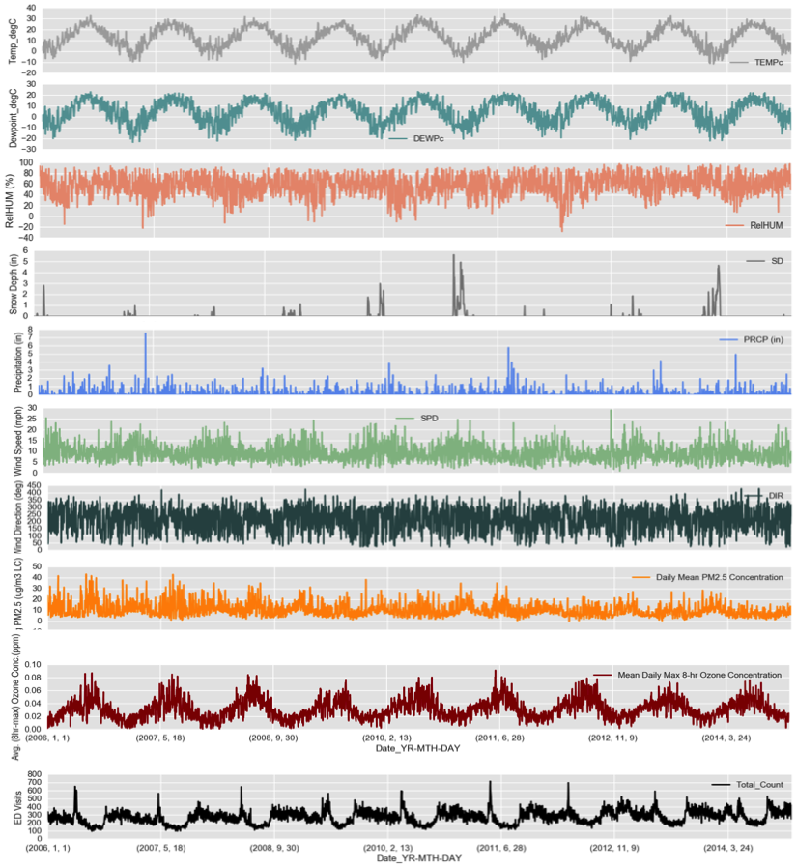



Methodology
10-fold CV Test-Train
Holdout
*2014
Temp
DewP
Humidity (%)
Snow (in)
Precp (in)
Wind_SPD (mpg)
Wind_Dir (°)
PM2.5
Ozone
ED visits
2006
DATE
2015
Notes:
Data –
2004-2014 Weather Variables (CDIAC – Carbon Dioxide Information Analysis Center)
2006-2014 Air Quality Environmental Protection Agency )
2006 –2014 Hospital Epi-Query ED Visits (Not diagnostic-based ) https://a816-healthpsi.nyc.gov/epiquery/Syndromic/)

Slide 5
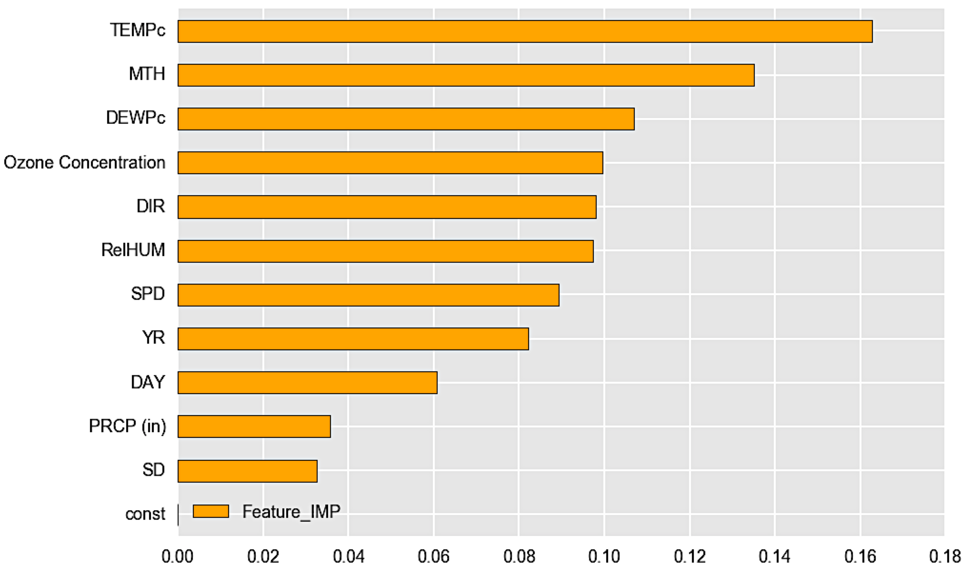
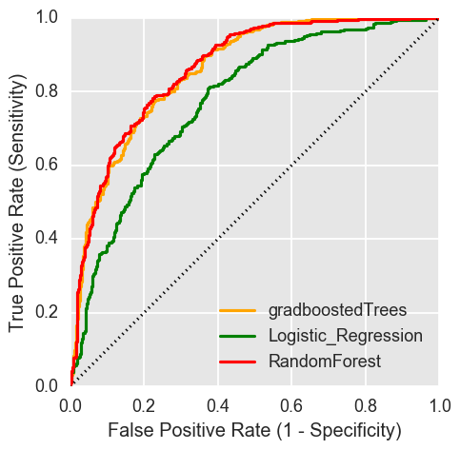
Features of importance
Notes:
http://ephtracking.cdc.gov/showIndicatorPages.action?selectedContentAreaAbbreviation=11&selectedIndicatorId=49&selectedMeasureId=
The number of high ozone days per year varies, which makes tracking trends over time difficult to analyze or interpret. The variability is largely due to the fact that: a) the number of high ozone days is related to temperature (as a result, there will be more high ozone days in hotter summers), and b) there are a small number of events (high ozone days) per year, so for statistical reasons, this type of measure may vary. The model predictions are used to fill in air quality estimates in areas and at times without monitoring data.
The relationship between ambient concentrations and personal exposure is largely unknown and variable depending upon pollutant, activity patterns, and microenvironments.

Slide 6
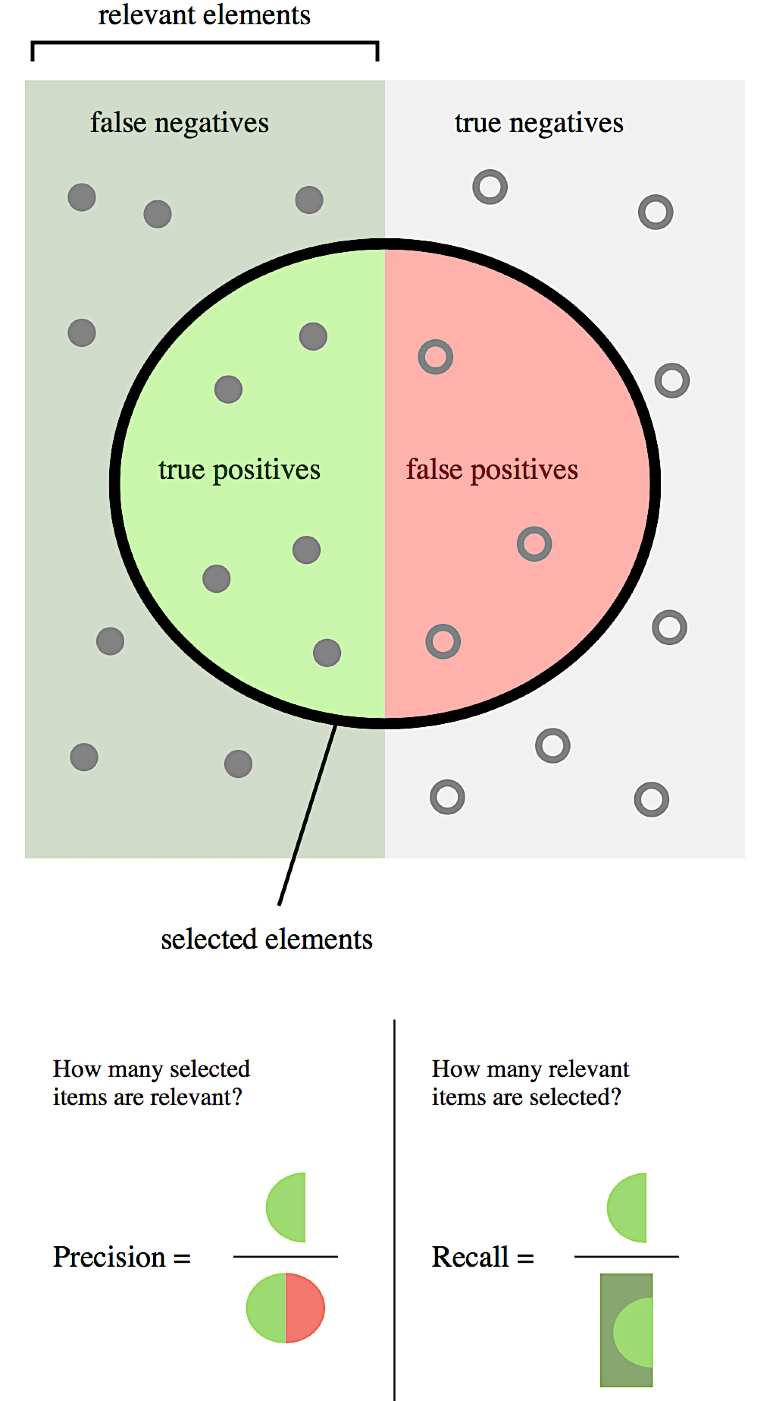
Precision & Recall
GBTrees |  | Precision | Recall
Training_Test | 0 | 0.73 | 0.75
 | 1 | 0.74 | 0.72
avg / total |  | 0.74 | 0.74
Holdout | 0 | 0.79 | 0.77
 | 1 | 0.76 | 0.78
avg / total |  | 0.77 | 0.77
Testing_2014 | 0 | 0.80 | 0.74
 | 1 | 0.86 | 0.90
avg / total |  | 0.83 | 0.82
Notes:
http://ephtracking.cdc.gov/showIndicatorPages.action?selectedContentAreaAbbreviation=11&selectedIndicatorId=49&selectedMeasureId=
The number of high ozone days per year varies, which makes tracking trends over time difficult to analyze or interpret. The variability is largely due to the fact that: a) the number of high ozone days is related to temperature (as a result, there will be more high ozone days in hotter summers), and b) there are a small number of events (high ozone days) per year, so for statistical reasons, this type of measure may vary. The model predictions are used to fill in air quality estimates in areas and at times without monitoring data.
The relationship between ambient concentrations and personal exposure is largely unknown and variable depending upon pollutant, activity patterns, and microenvironments.

Slide 7

A calendar chart app. for prospective resource management

Slide 8
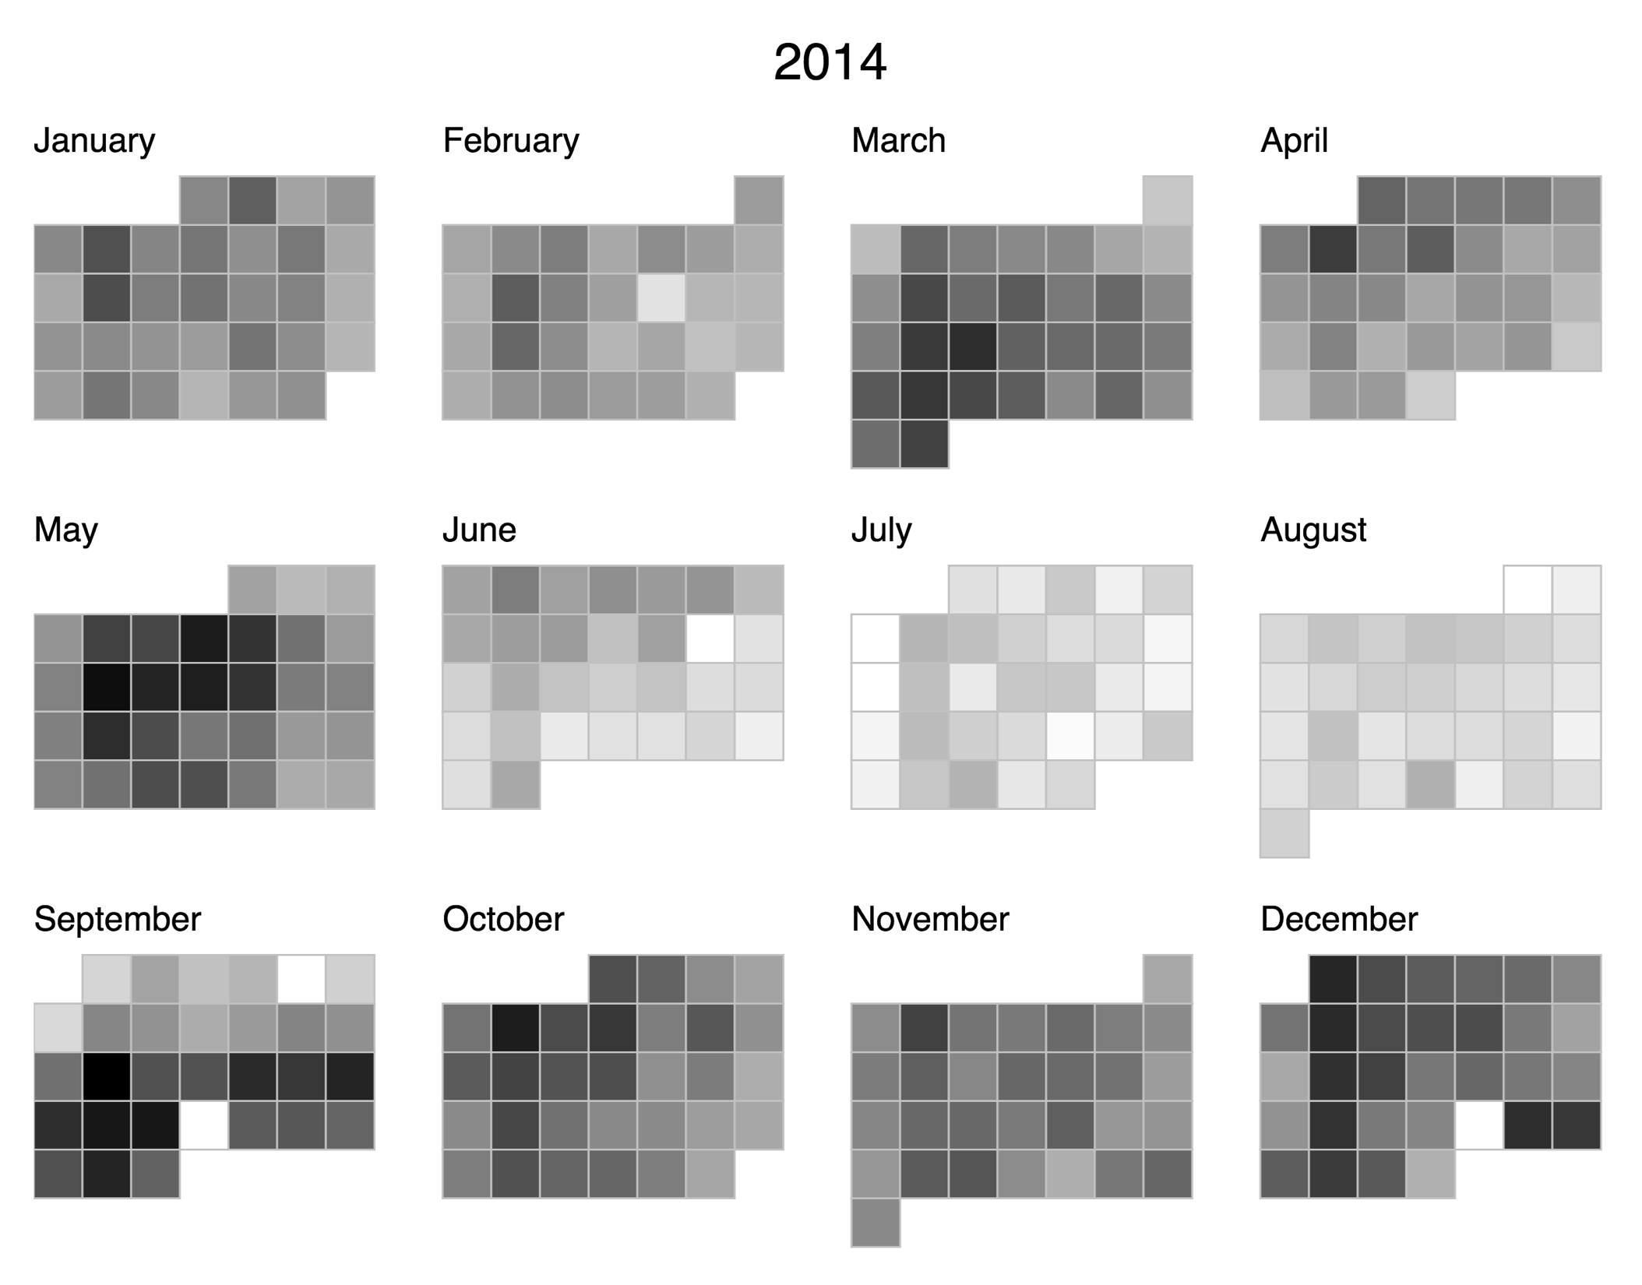
A calendar chart app. for prospective resource management

Slide 9
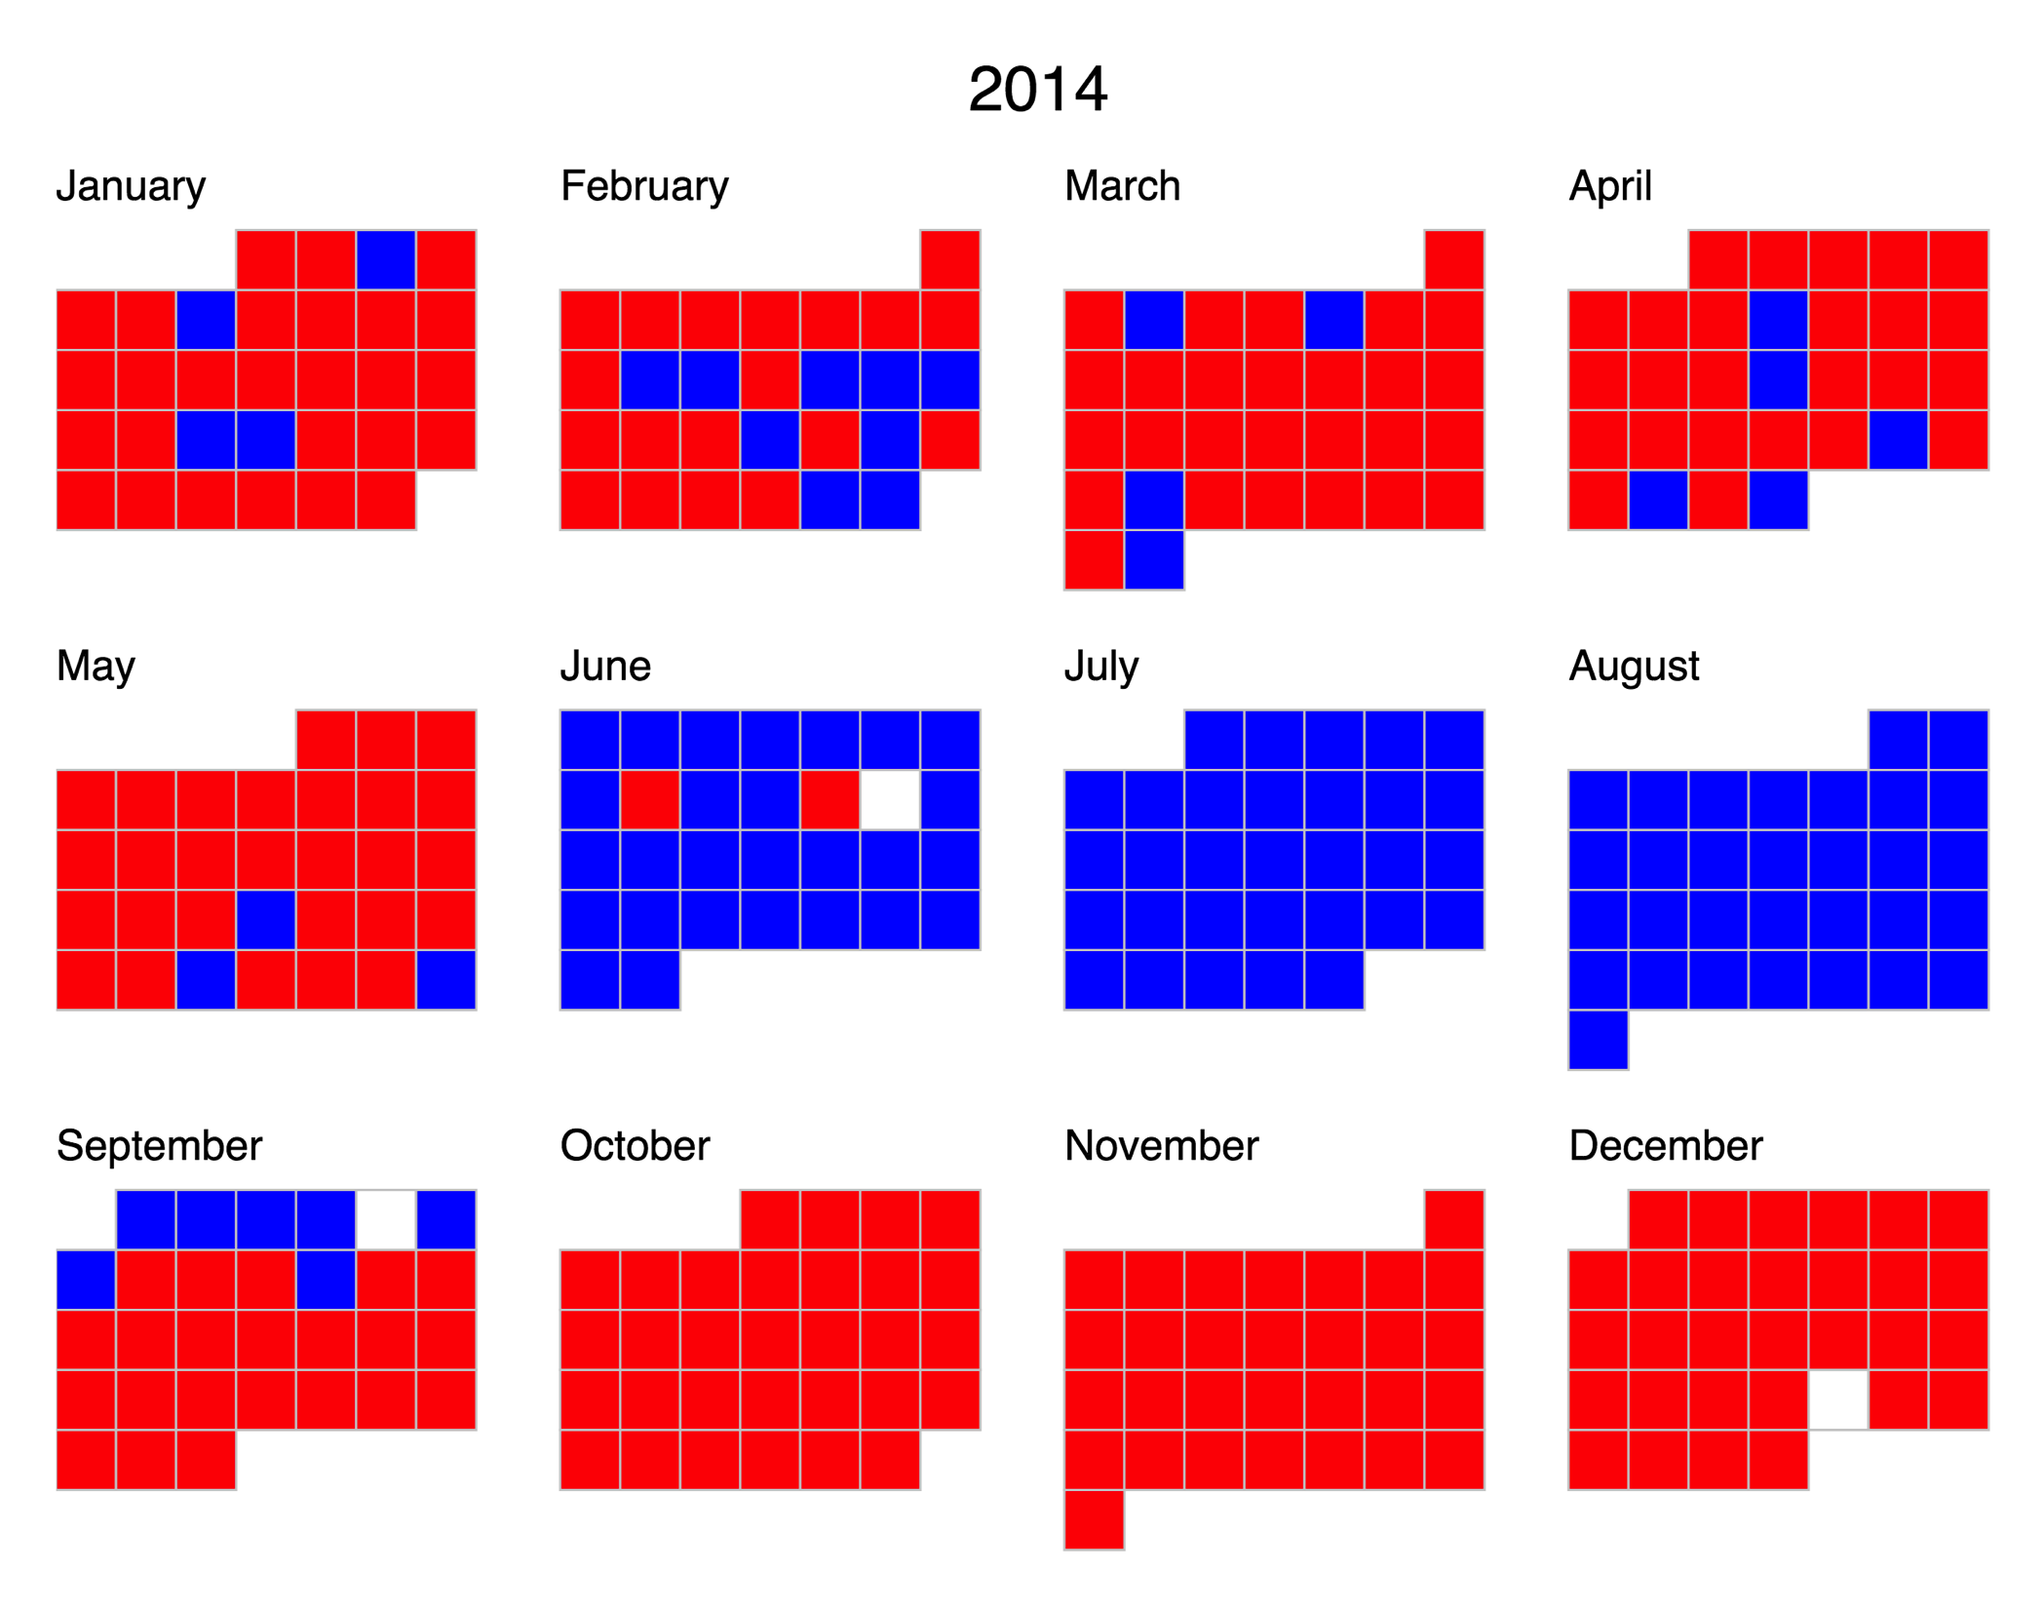
Online model updating when data is available to improve prediction

Slide 10
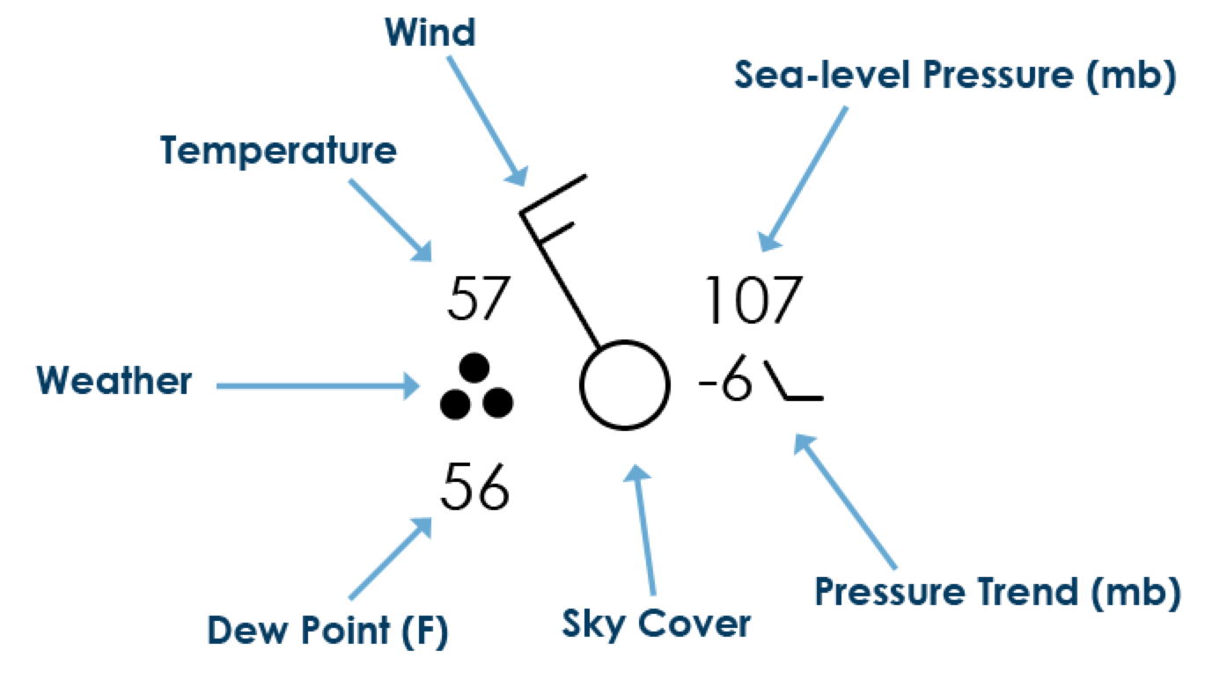
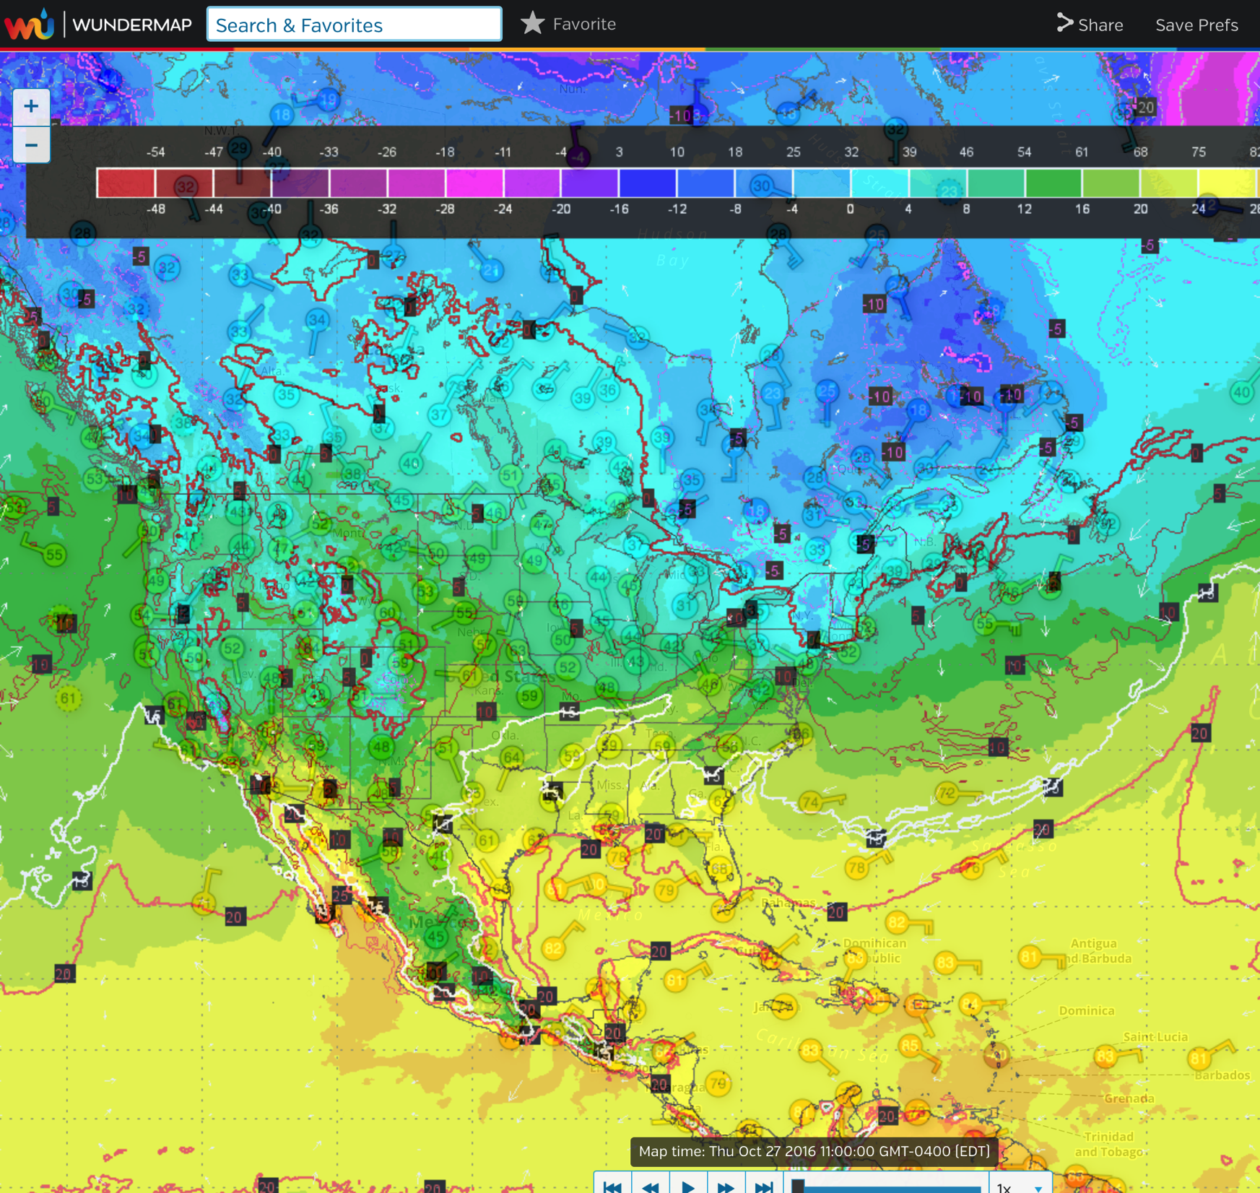
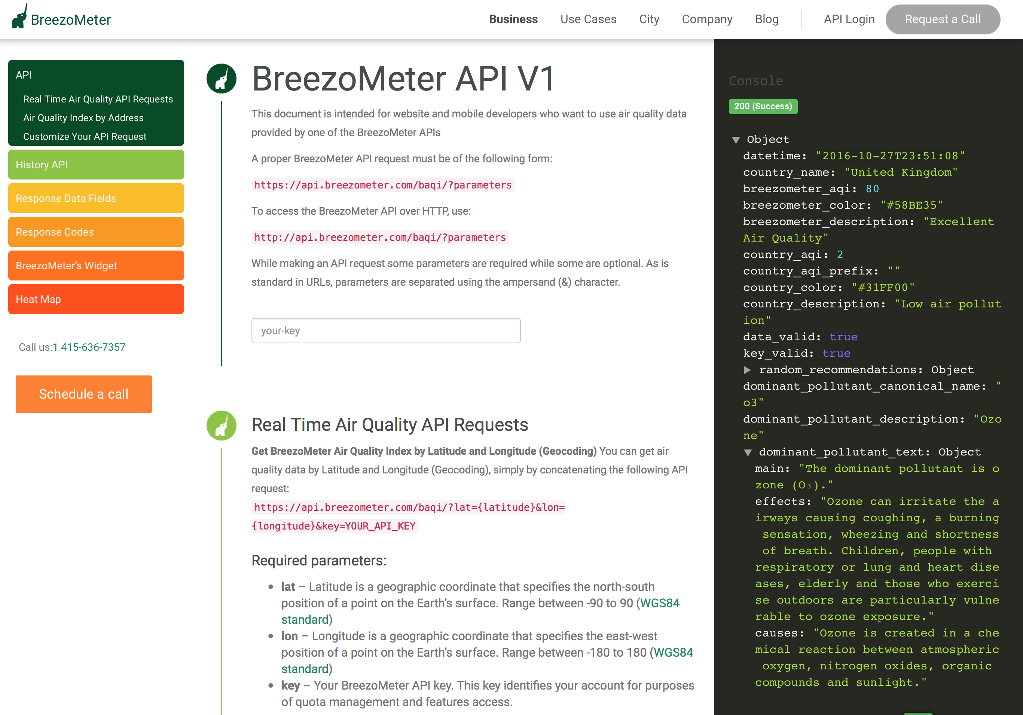
Integrating weather + air quality forecasts in the modeling:

Slide 11
Further work + extension
Working with weather experts in modeling weather data and forecasting:
Ozone and particulate matter may interact in complex ways to act as irritants.
ED visits for different age-groups – varying needs.
Extending this to other counties/cities/countries/ fields.
May also provide suitable precautionary alerts for those with asthma or respiratory diseases.

Slide 12
Predicting the Number of Asthma Patients Visiting the Emergency Department
Heng-Ru May Tan
hengrumay@gmail.com

Slide 13
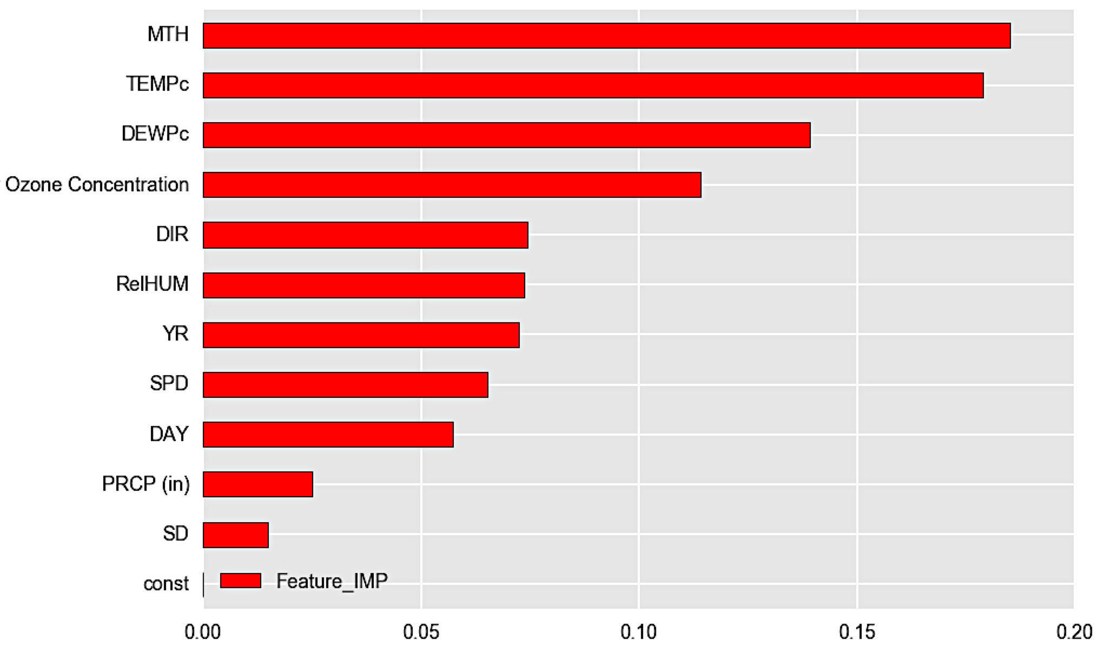
Methodology

Slide 14
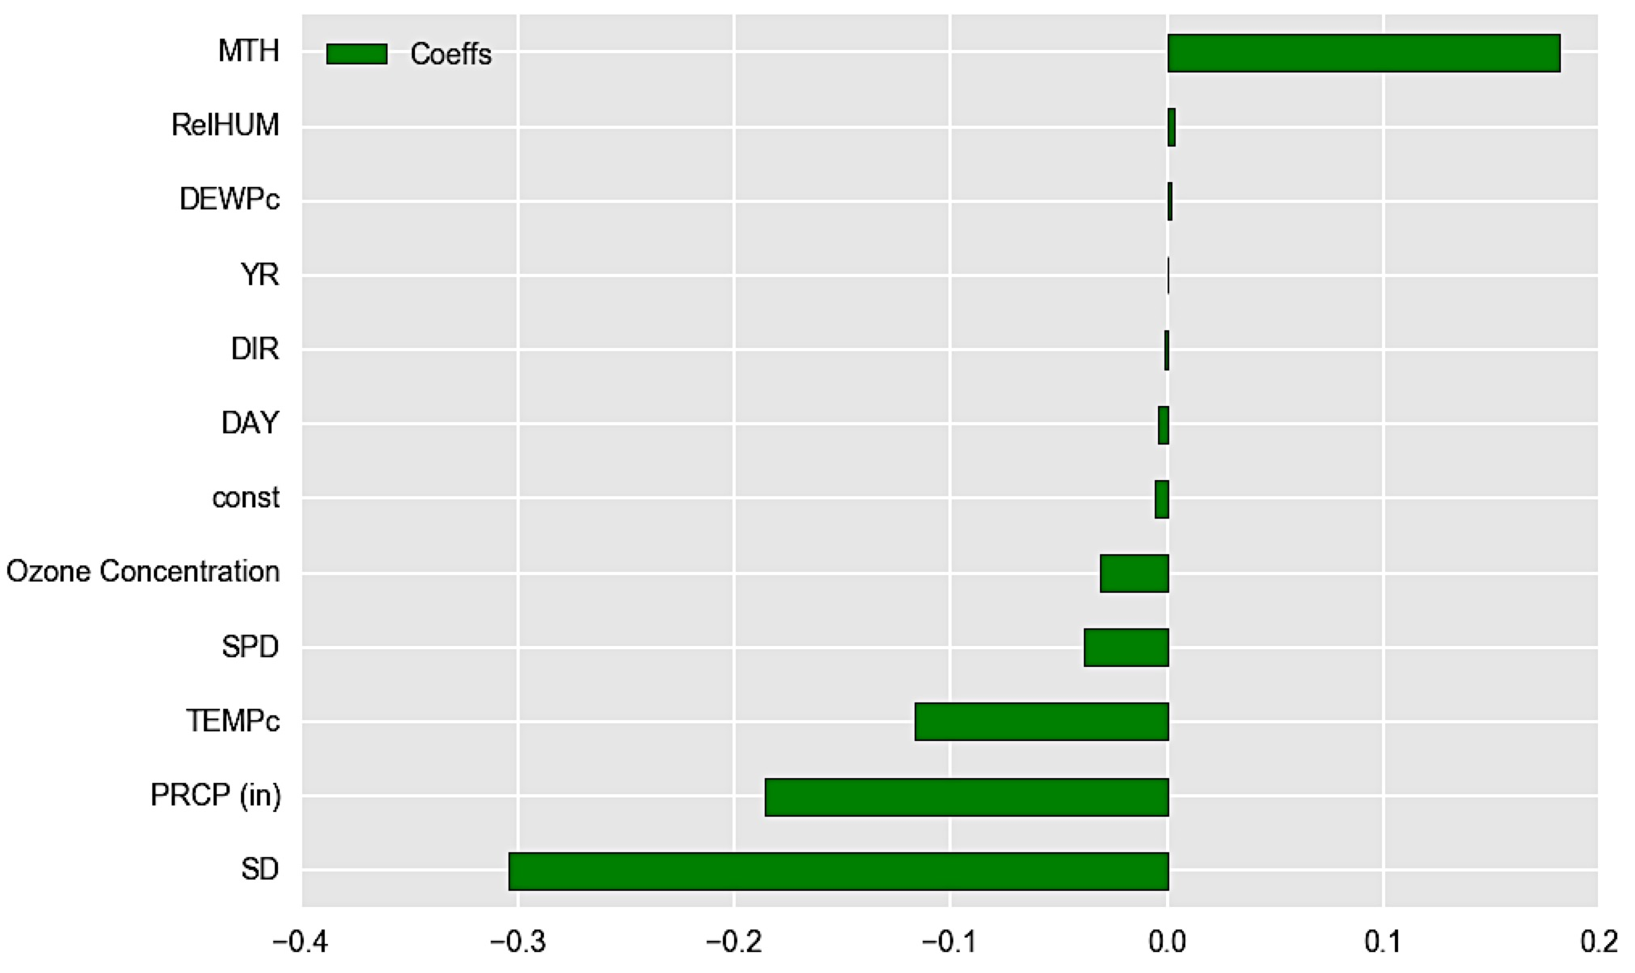
Methodology

Slide 15
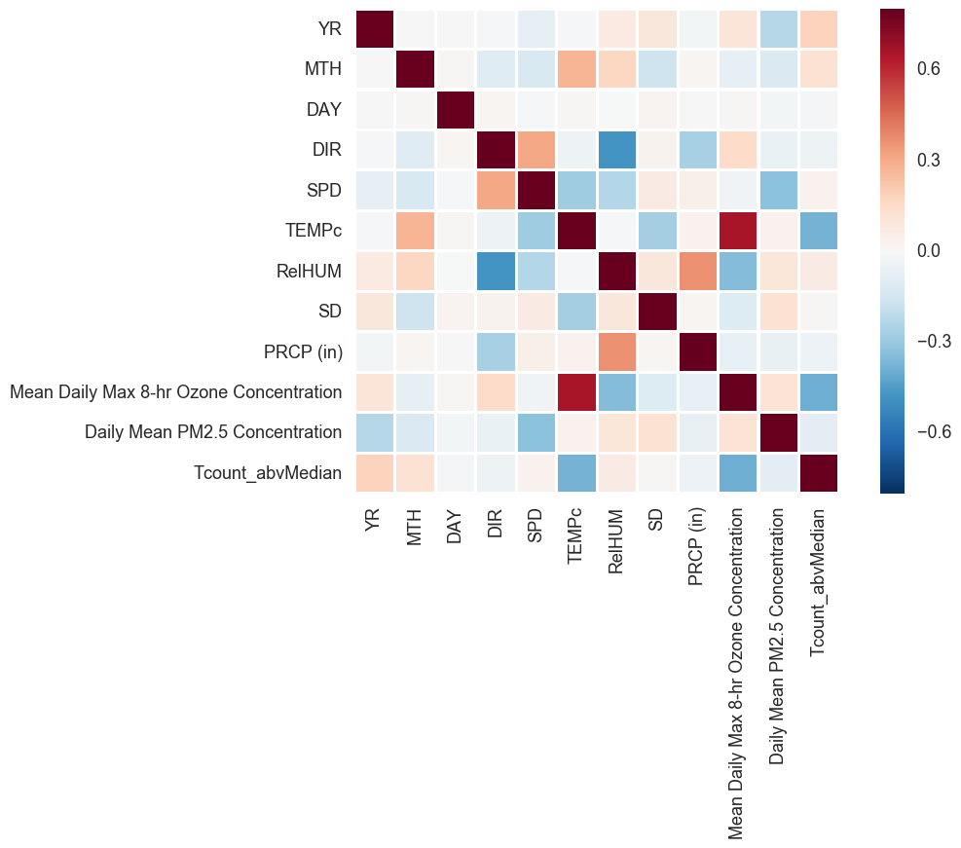

Slide 16
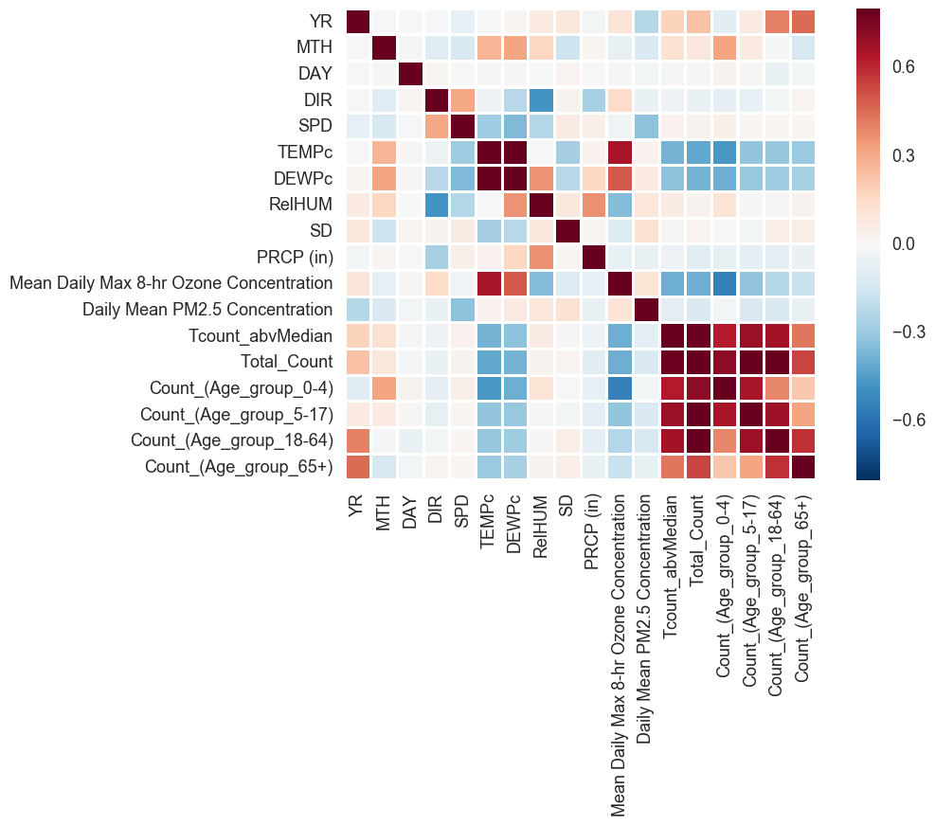

Slide 17
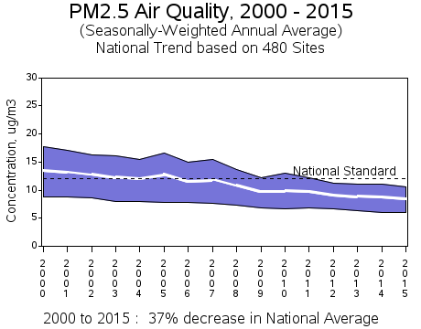
Notes:
https://www.epa.gov/air-trends/particulate-matter-pm25-trends
https://airnow.gov/index.cfm?action=aqibasics.particle

